Slide 1
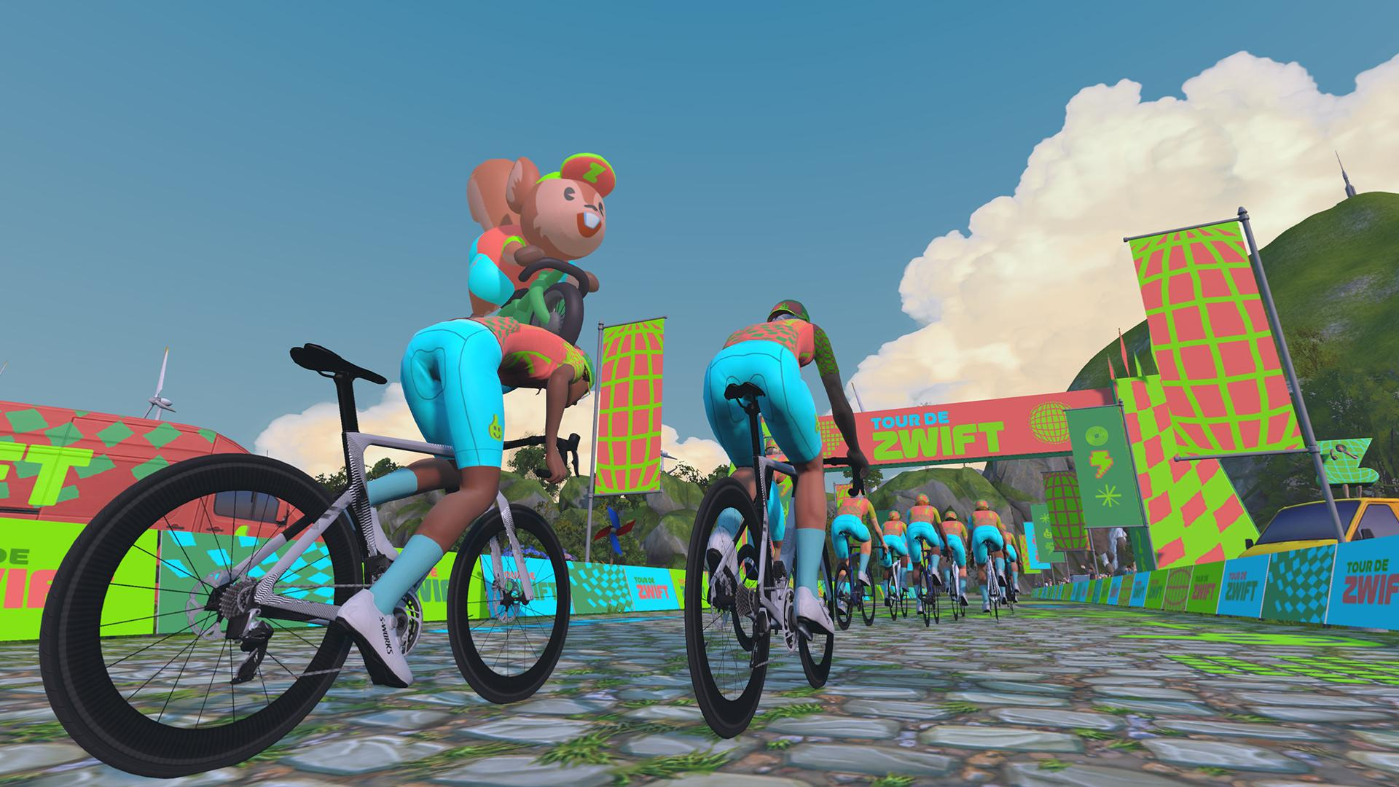
GROUP B4
‘Funking Baxter’ Peter King Phoebe Macwhinnie Alexandra Chuchu James Turner Patricia Villar Alessandra Scaduto
GROUP B3 (+4 mins)
Tom Bagley Luke Fenney Mark Stancombe Harvey Jackson Matt Wynn Martyn Hopping
GROUP B2 (+10 mins)
Gareth Edwards Alex Wilson-Jones Justin Goold Rob Cherry Chris Croft Simon White David Griffiths Richard Harrison Alex Joss Russell Beard Jeremy Sharpe Nick Dumonde Hans Stiles
GROUP B1 (+15 mins)
Adam Currie David Willis Paul Davey Luke Benfield David Goddard Rich Southcott Joe Barrett Sean Haywood
‘B’ RACE GROUPS

Slide 2
GROUP A3
James Bowden Olly Wright Gordon Reid Richard Halls James Armitage-Hobbs Alex Tate Bill McClatchie David Wong Eamon Mason Alex Robertson Rupert Gordon-Watkins
GROUP A2 (+5 mins)
Jonny Bodey ‘Real’ Neal Beauchamp Henrik Persson Neil Grunshaw Tom Herbert ‘Dirty’ Denis Whelan Marcus Jones Tobi Rosenkranz Matt de Freitas Chris Jenkins
GROUP A1 (+10 mins)
Tom Kennett Raif Oz Seb Ashton Conor Walsh Judah Rand
‘A’ RACE GROUPS

